Slide 1
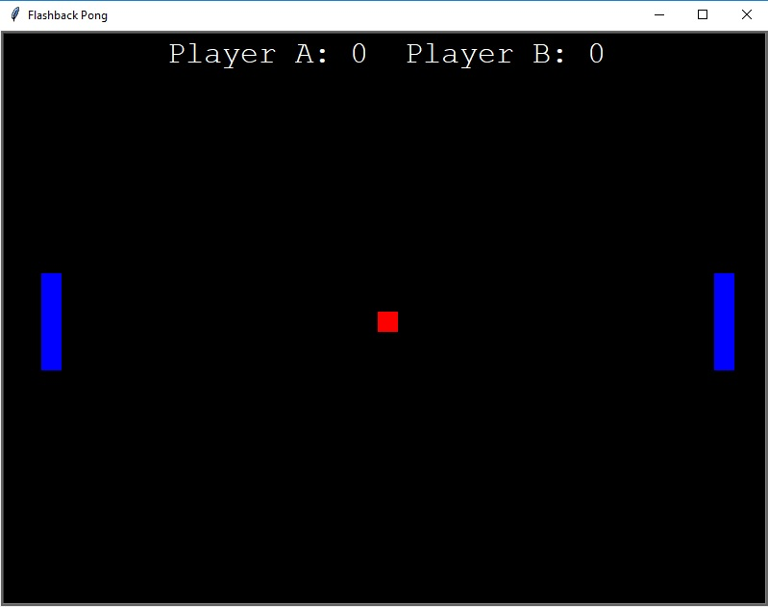
Flashback Pong
Ready to enjoy a modern twist to a favorite classic? Introducing Flashback Pong, relive your 70s childhood or dive into something new with this addicting, yet simple game. Try it today!
By: Jonathan Cruse

